Slide 1
UNIT I
OVERVIEW OF
OPERATING SYSTEMS

Slide 2
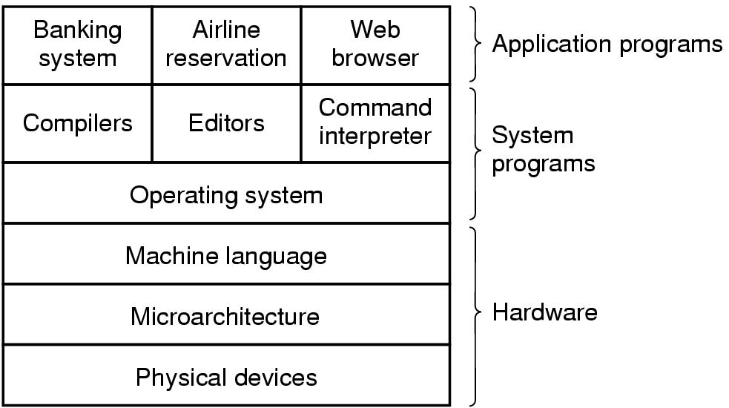
Introduction
A computer system consists of
hardware
system programs
application programs

Slide 3
What is an Operating System
It is an extended machine
Hides the messy details which must be performed
Presents user with a virtual machine, easier to use
It is a resource manager
Each program gets time with the resource
Each program gets space on the resource

Slide 4
TYPES of RESOURCES
System provided resources : CPU, memories, I O devices
for allocation it considers efficiency of resource utilization
User created resources : files and folders allocation is based on set of constraints specified by creator, it depends on access , rights & privileges

Slide 5
History of Operating Systems
First generation 1945 - 1955
vacuum tubes, plug boards
Second generation 1955 - 1965
transistors, batch systems
Third generation 1965 – 1972
ICs and multiprogramming
Fourth generation 1972-1980 – present
personal computers
Fifth generation OS – 1982 onwards was initiated to create computers using massively parallel computing and logic programming
Sixth generations OS – These are called as intelligent computers based on AI OR artificial brains

Slide 6
O S Functions
Resource allocation & related functions : It is sharing of resources by user. It also performs binding of set of resources with requesting pgm.
protection of users who r sharing set of resources against mutual interference
User Interface Functions : allows creation & use of appropriate computational structure by a user
it involves use of command language or menu

Slide 7
Other functions
Memory management
Process management
Protection of user from one another

Slide 8
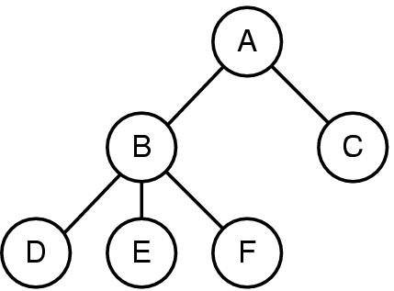
Operating System Concepts
A process tree
A created two child processes, B and C
B created three child processes, D, E, and F

Slide 9
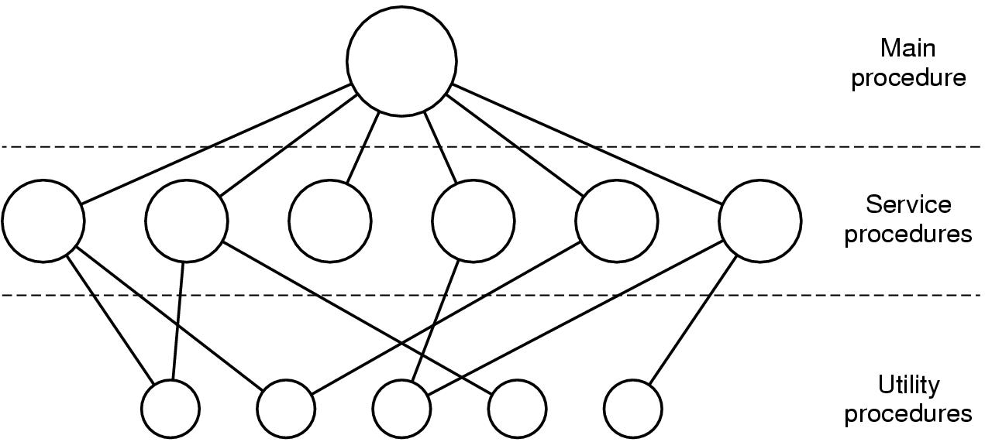
Operating System Structure
Simple structuring model for a monolithic system

Slide 10
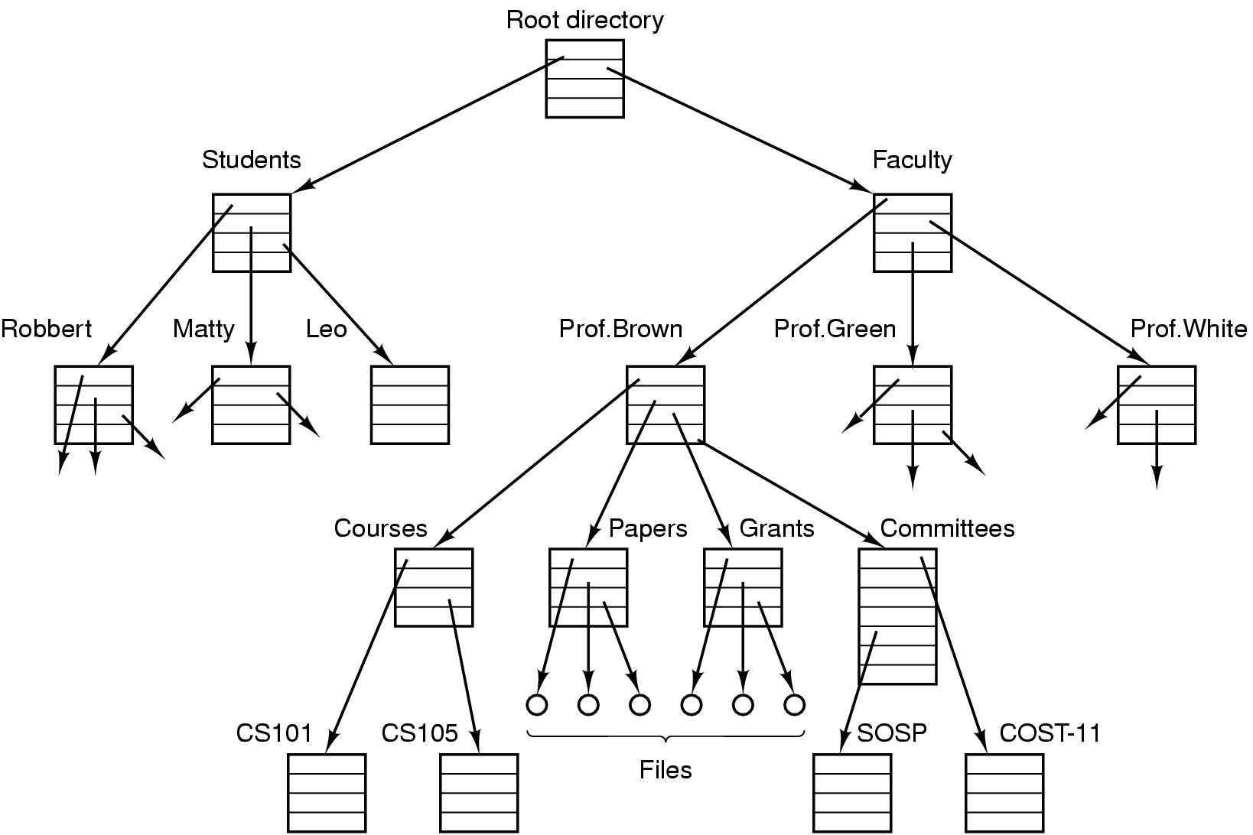
Operating System Concepts
File system for a university department

Slide 11
OS EVOLUTION and TYPES
Batch OS : req grouping of similar jobs ( with same data pgms & system commands)
Multiprogramming OS : involves multitasking, multiprocessing, multiuser & time sharing systems
Real Time OS : large no of events which r external to comp system – are accepted & data is processed (on line operations & data eg ATM etc)
N/W OS
Distributed OS : looks as ordinary centralized system but users are acting independently

Slide 12
IMP Terms
CPU sharing : shared in sequential manner. Only one pgmm gets executed at a time.
CPU scheduling : decides which pgmm should be given to CPU(priority) and for how much time

Slide 13
Resource preemption : it is forceful deallocation of a resource. It is used by OS to enforce fairness in their use by pgms.
Memory sharing : not exact sharing or not concurrent sharing but
its availability can be increased by treating diff parts of memory as diff resources. (two methods : partitioning & pool based allocation)

Slide 14
Other terms
Programs : eg. an object code to be executed. It consists of set of pgm units + pgm units obtained from libraries
Process : An execution of a program or part of a program. (many processes together can execute a pgm or part of a pgm)

Slide 15
Job : it is computational structure which is a sequence of pgms. It consists of seq of job steps.

Slide 16
VIRTUAL MACHINES

Slide 17
Virtual Machine abstracts the hardware of our personal computer such as CPU, disk drives, memory, NIC (Network Interface Card) etc, into many different execution environments as per our requirements, hence giving us a feel that each execution environment is a single computer. For example, VirtualBox

Slide 18
VM is like fake computer system operating on your hardware. It partially uses the hardware of your system (like CPU, RAM, disk space, etc.) but its space is completely separated from your main system. Two virtual machines don’t interrupt in each other’s working and functioning nor they can access each other’s space which gives an illusion that we are using totally different hardware system.

Slide 19
LIMITATIONS
In general there is no limit because it depends on the hardware of your system. As the VM is using hardware of your system, if it goes out of it’s capacity then it will limit you not to install further virtual machines.

Slide 20
Can we access the files of one VM from another :
In general No, but as an advanced hardware feature, we can allow the file-sharing (other resource sharing) for different virtual machines

Slide 21
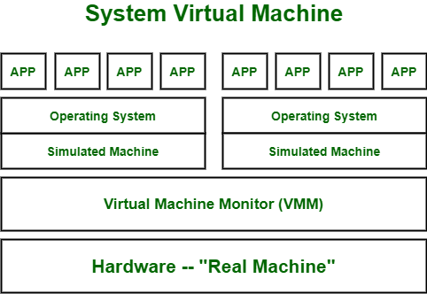
Types

Slide 22
These types of virtual machines gives us complete system platform and gives the execution of the complete virtual operating system. Just like virtual box, system virtual machine is providing an environment for an OS to be installed completely. We can see in image that our hardware of Real Machine is being distributed between two simulated operating systems by Virtual machine monitor. And then some programs, processes are going on in that distributed hardware of simulated machines separately

Slide 23
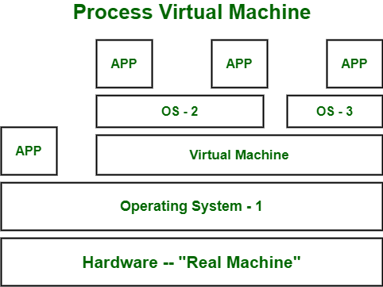

Slide 24
Virtual Machine Language : It’s type of language which can be understood by different operating systems. It is platform-independent. Just like to run any programming language (C, python, or java) we need specific compiler that actually converts that code into system understandable code
The same virtual machine language works. If we want to use code that can be executed on different types of operating systems like (Windows, Linux, etc) then virtual machine language will be helpful.

Slide 25
Advantages:
There are no protection problems because each virtual machine is completely isolated from all other virtual machines.
Virtual machine can provide an instruction set architecture that differs from real computers.
Easy maintenance, availability and convenient recovery

Slide 26
Disadvantages:
When multiple virtual machines are simultaneously running on a host computer, one virtual machine can be affected by other running virtual machines, depending on the workload.
Virtual machines are not as efficient as a real one when accessing the hardware

Slide 27
System Calls
System calls provide the interface between a running program and the operating system.
Generally available as assembly-language instructions.
Languages defined to replace assembly language for systems programming allow system calls to be made directly (e.g., C, C++)

Slide 28
Three general methods are used to pass parameters between a running program and the operating system.
Pass parameters in registers.
Store the parameters in a table in memory, and the table address is passed as a parameter in a register.
Push (store) the parameters onto the stack by the program, and pop off the stack by operating system.

Slide 29
PROCESS
It is a program while it is being executed
It includes
1. value of program counter
2. contents of CPU register
3. process stack with temporary data
4. data section containing global variables
5. program code
6. dynamically allocated memory during runtime

Slide 30
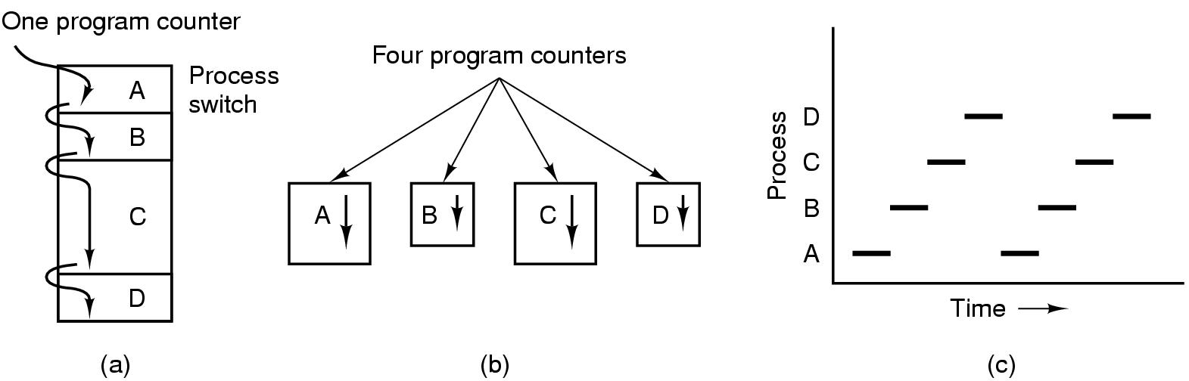
Processes The Process Model
Multiprogramming of four programs
Conceptual model of 4 independent, sequential processes
Only one program active at any instant

Slide 31
Process Creation
Principal events that cause process creation
System initialization
Execution of a process creation system
User request to create a new process
Initiation of a batch job

Slide 32
Process Termination
Conditions which terminate processes
Normal exit (voluntary)
Error exit (voluntary)
Fatal error (involuntary)
Killed by another process (involuntary)

Slide 33
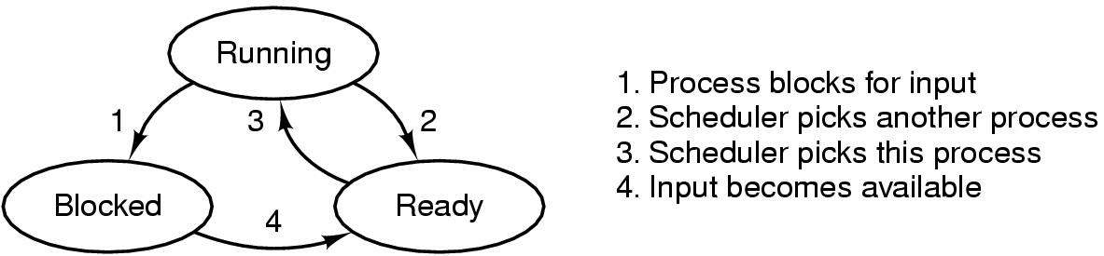
Process States
Possible process states
running
blocked
ready
Transitions between states shown

Slide 34
Process State
As a process executes, it changes state
new: The process is being created.
running: Instructions are being executed.
waiting: The process is waiting for some event to occur.
ready: The process is waiting to be assigned to a process.
terminated: The process has finished execution.

Slide 35
Process state transition diagram
NEW
READY
RUNNING
TERMINATED
BLOCKED / WAITING

Slide 36
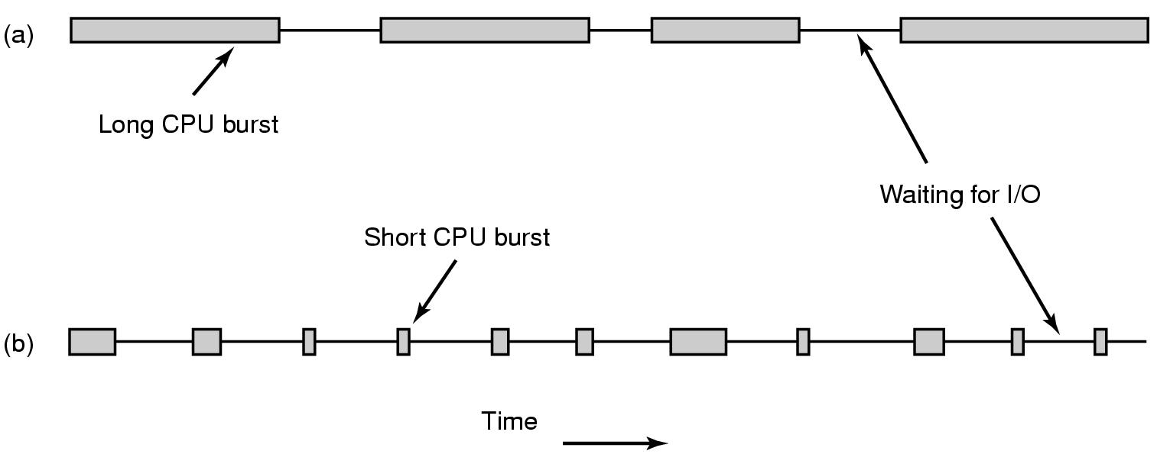
Scheduling Introduction to Scheduling (1)
Bursts of CPU usage alternate with periods of I/O wait
a CPU-bound process
an I/O bound process

Slide 37
Chapter 6: CPU Scheduling
Basic Concepts
Scheduling Criteria
Scheduling Algorithms
Multiple-Processor Scheduling
Real-Time Scheduling
Algorithm Evaluation

Slide 38
TYPES of SCHEDULERS
Long Term : it determines which job shall be admitted for processing.
it maintains proper mixture of CPU bound and I/O bound jobs in ready queue. It selects a new process from among all waiting processes using SJF or FCFS strategy.
Short Term : it is called in case of I/O request.
it is called at the end of time slab. It allocates processes belonging to ready queue to CPU for immediate processing.

Slide 39
Medium Term : If many processes are waiting for I/O processes , some of the processes need to be suspended. So such pro will be moved to hard disk from main memory. These are reloaded to main memory at some later time. ( swapping)

Slide 40
Scheduling Methods
Preemptive scheduling : here CPU can be taken away from the process. Process can be temporarily suspended due to
A. I/O request
B. Time slab is over
Non – preemptive scheduling : here process runs to its completion. Once CPU is allotted for one process, it can’t be taken away upto its completion.

Slide 41
Basic Concepts
Maximum CPU utilization obtained with multiprogramming
CPU–I/O Burst Cycle – Process execution consists of a cycle of CPU execution and I/O wait.
CPU burst distribution

Slide 42
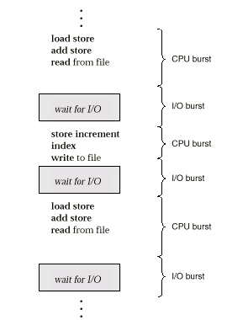
Alternating Sequence of CPU And I/O Bursts

Slide 43
Scheduling Criteria
CPU utilization – keep the CPU as busy as possible
Throughput – # of processes that complete their execution per time unit
Turnaround time – amount of time to execute a particular process
Waiting time – amount of time a process has been waiting in the ready queue
Response time – amount of time it takes from when a request was submitted until the first response is produced, not output (for time-sharing environment)

Slide 44
Optimization Criteria
Max CPU utilization
Max throughput
Min turnaround time
Min waiting time
Min response time

Slide 45
First-Come, First-Served (FCFS) Scheduling
Process Burst Time
P₁ 24
P₂ 3
P₃ 3
Suppose that the processes arrive in the order: P₁ , P₂ , P₃ The Gantt Chart for the schedule is: Waiting time for P₁ = 0; P₂ = 24; P₃ = 27
Average waiting time: (0 + 24 + 27)/3 = 17
P₁
P₂
P₃
0
24
27
30

Slide 46
FCFS Scheduling (Cont.)
Suppose that the processes arrive in the order
P₂ , P₃ , P₁ .
The Gantt chart for the schedule is:
Waiting time for P₁ = 6; P₂ = 0; P₃ = 3
Average waiting time: (6 + 0 + 3)/3 = 3
Much better than previous case.
Convoy effect short process behind long process
P₂
P₃
P₁
0
3
6
30

Slide 47
Shortest-Job-First (SJR) Scheduling
Associate with each process the length of its next CPU burst. Use these lengths to schedule the process with the shortest time.
Two schemes:
nonpreemptive – once CPU given to the process it cannot be preempted until completes its CPU burst.
preemptive – if a new process arrives with CPU burst length less than remaining time of current executing process, preempt. This scheme is know as the Shortest-Remaining-Time-First (SRTF).
SJF is optimal – gives minimum average waiting time for a given set of processes.

Slide 48
Example of Non-Preemptive SJF
Process Arrival Time Burst Time
P₁ 0.0 7
P₂ 2.0 4
P₃ 4.0 1
P₄ 5.0 4
SJF (non-preemptive)
Average waiting time = (0 + 6 + 3 + 7)/4 = 4
P₁
P₃
P₂
P₄
0
3
7
8
12
16

Slide 49
Example of Preemptive SJF
Process Arrival Time Burst Time
P₁ 0.0 7
P₂ 2.0 4
P₃ 4.0 1
P₄ 5.0 4
SJF (preemptive)
Average waiting time = (9 + 1 + 0 +2)/4 = 3
P₁
P₂
P₃
P₂
P₄
P₁
0
2
4
5
7
11
16

Slide 50
Priority Scheduling
A priority number (integer) is associated with each process
The CPU is allocated to the process with the highest priority (smallest integer ≡ highest priority).
Preemptive
nonpreemptive
SJF is a priority scheduling where priority is the predicted next CPU burst time.
Problem ≡ Starvation – low priority processes may never execute.
Solution ≡ Aging – as time progresses increase the priority of the process.

Slide 51
Round Robin (RR)
Each process gets a small unit of CPU time (time quantum), usually 10-100 milliseconds. After this time has elapsed, the process is preempted and added to the end of the ready queue.
If there are n processes in the ready queue and the time quantum is q, then each process gets 1/n of the CPU time in chunks of at most q time units at once. No process waits more than (n-1)q time units.
Performance
q large ⇒ FIFO
q small ⇒ q must be large with respect to context switch, otherwise overhead is too high.

Slide 52
Example of RR with Time Quantum = 20
Process Burst Time
P₁ 53
P₂ 17
P₃ 68
P₄ 24
The Gantt chart is:
Typically, higher average turnaround than SJF, but better response.
P₁
P₂
P₃
P₄
P₁
P₃
P₄
P₁
P₃
P₃
0
20
37
57
77
97
117
121
134
154
162

Slide 53
THREADS
Low cost alternatives to processes for certain concurrent applications.
Each pro : have single addr space & single thread of control
Sometimes it may have multiple threads of control & they share a single addr space.

Slide 54
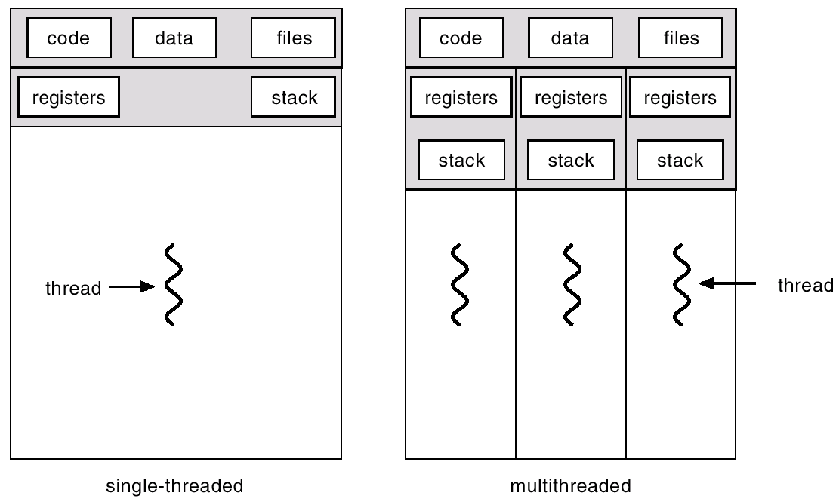
Single and Multithreaded Processes

Slide 55
Multithreading Models
Many-to-One
One-to-One
Many-to-Many

Slide 56
Many-to-One
Many user-level threads mapped to single kernel thread.
Used on systems that do not support kernel threads.

Slide 57
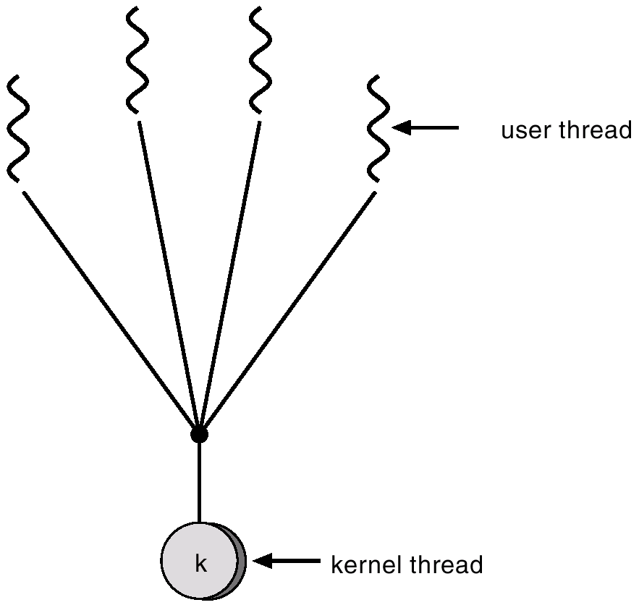
Many-to-One Model

Slide 58
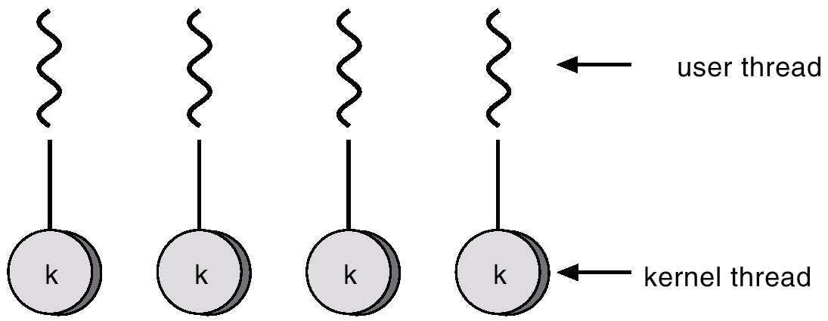
One-to-one Model
Each user-level thread maps to kernel thread.
Examples
- Windows 95/98/NT/2000 - OS/2

Slide 59
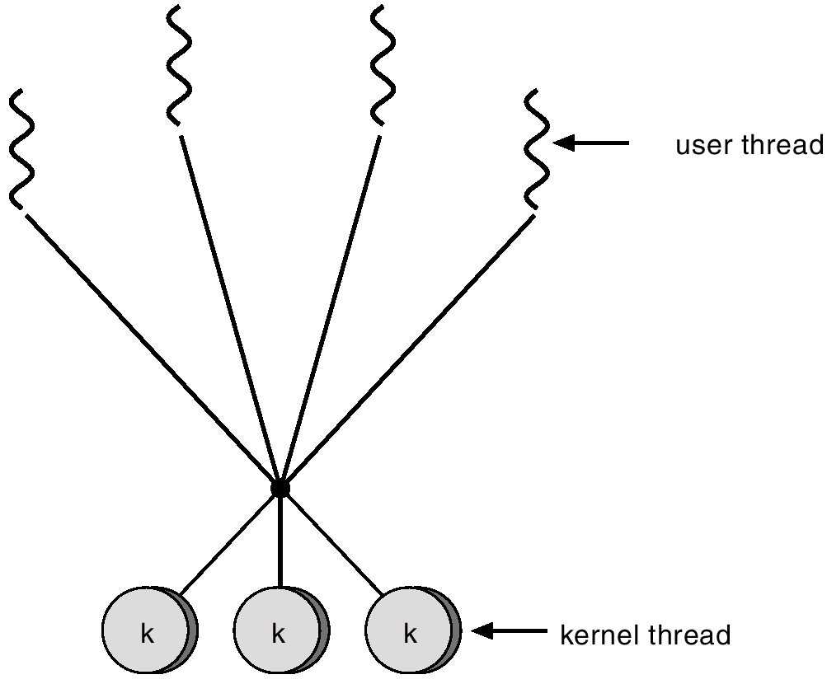
Many-to-Many Model

Slide 60
Allows many user level threads to be mapped to many kernel threads. Allows the operating system to create a sufficient number of kernel threads. Solaris 2 Windows NT/2000 with the Thread Fiber package

Slide 61
DEADLOCKS

Slide 62
The Deadlock Problem
A set of blocked processes each holding a resource and waiting to acquire a resource held by another process in the set.
Example
System has 2 tape drives.
P₁ and P₂ each hold one tape drive and each needs another one.
Example
semaphores A and B, initialized to 1
P₀ P₁
wait (A); wait(B)
wait (B); wait(A)

Slide 63
Bridge Crossing Example
Traffic only in one direction.
Each section of a bridge can be viewed as a resource.
If a deadlock occurs, it can be resolved if one car backs up (preempt resources and rollback).
Several cars may have to be backed up if a deadlock occurs.
Starvation is possible.

Slide 64
System Model
Resource types R₁, R₂, . . ., R_{m}
CPU cycles, memory space, I/O devices
Each resource type R_{i} has W_{i} instances.
Each process utilizes a resource as follows:
request
use
release

Slide 65
Deadlock Characterization
Deadlock can arise if four conditions hold simultaneously.
Mutual exclusion: only one process at a time can use a resource.
Hold and wait: a process holding at least one resource is waiting to acquire additional resources held by other processes.
No preemption: a resource can be released only voluntarily by the process holding it, after that process has completed its task.
Circular wait: there exists a set {P₀, P₁, …, P₀} of waiting processes such that P₀ is waiting for a resource that is held by P₁, P₁ is waiting for a resource that is held by
P₂, …, P_{n–1} is waiting for a resource that is held by P_{n}, and P₀ is waiting for a resource that is held by P₀.

Slide 66
Resource-Allocation Graph
A set of vertices V and a set of edges E.
V is partitioned into two types:
P = {P₁, P₂, …, P_{n}}, the set consisting of all the processes in the system.
R = {R₁, R₂, …, R_{m}}, the set consisting of all resource types in the system.
request edge – directed edge P₁ → R_{j}
assignment edge – directed edge R_{j} → P_{i}

Slide 67
Resource-Allocation Graph (Cont.)
Process Resource Type with 4 instances
P_{i} requests instance of R_{j}
P_{i} is holding an instance of R_{j}
P_{i}
R_{j}
P_{i}
R_{j}

Slide 68
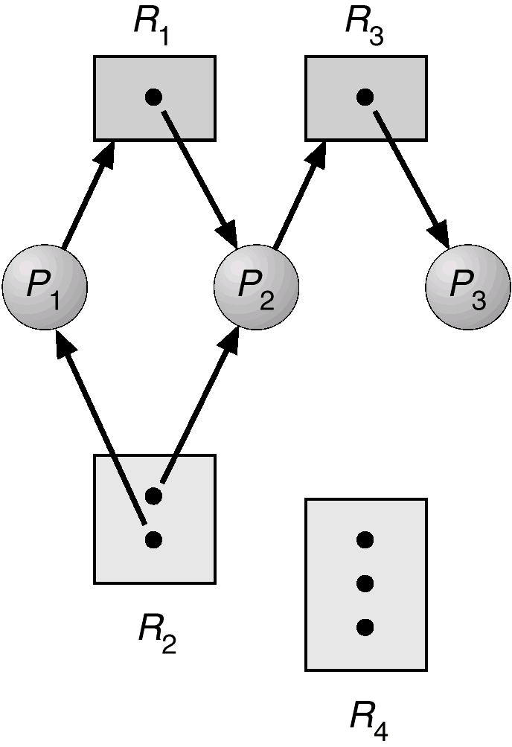
Example of a Resource Allocation Graph

Slide 69
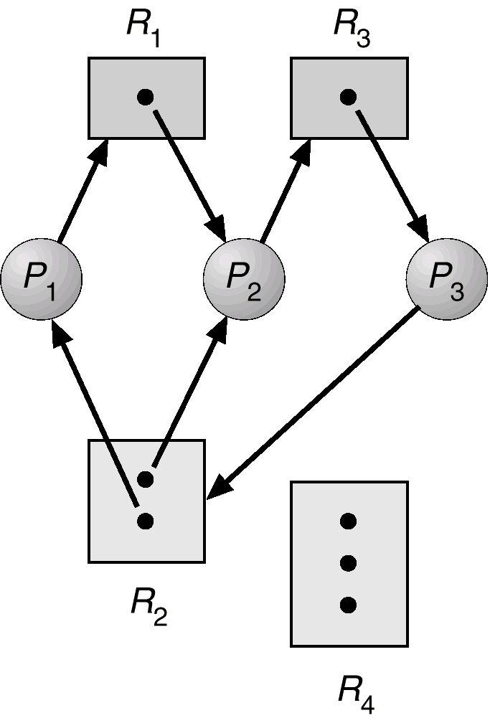
Resource Allocation Graph With A Deadlock

Slide 70
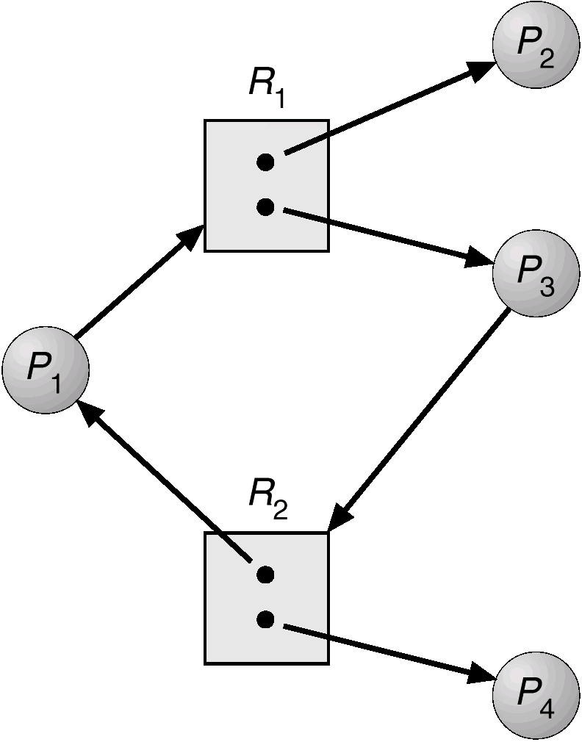
Resource Allocation Graph With A Cycle But No Deadlock

Slide 71
Basic Facts
If graph contains no cycles ⇒ no deadlock.
If graph contains a cycle ⇒
if only one instance per resource type, then deadlock.
if several instances per resource type, possibility of deadlock.

Slide 72
Methods for Handling Deadlocks
Ensure that the system will never enter a deadlock state.
Allow the system to enter a deadlock state and then recover.
Ignore the problem and pretend that deadlocks never occur in the system; used by most operating systems, including UNIX.

Slide 73
Deadlock Prevention
Restrain the ways request can be made.
Mutual Exclusion – not required for sharable resources; must hold for nonsharable resources.
Hold and Wait – must guarantee that whenever a process requests a resource, it does not hold any other resources.
Require process to request and be allocated all its resources before it begins execution, or allow process to request resources only when the process has none.
Low resource utilization; starvation possible.

